Slide 1

MAULANA AZAD
NATIONAL INSTITUTE OF TECHNOLOGY
BHOPAL, INDIA, 462003
DEPARTMENT OF COMPUTER SCIENCE & ENGINEERING

Slide 2
Title of the Project
Employee Management System-
(using SQLIte)
Project Mentor | Project Guide
Dr. Deepak Singh Tomar- (H.O.D CSE) | Amit Gupta

Slide 3
Project Team
Name | Scholar Number | Section
Atharva Kulkarni | 201112276 | CSE 2
Aryan Rajawat | 201112213 | CSE 2
Tushar Bhuriya | 201112238 | CSE 2

Slide 4
What is CleanCrew
CleanCrew is a web-based employee management system designed to streamline workforce management for cleaning companies. It offers features such as employee scheduling, task management, and call logging, enabling supervisors to manage their teams efficiently. CleanCrew simplifies communication between supervisors and employees by providing contact details and a call feature that allows supervisors to reach out to their workers easily. The system's user-friendly interface and intuitive design make it easy for users to get started and take advantage of all the system's features. Overall, CleanCrew is a powerful tool that helps cleaning companies optimize their workforce management and improve operational efficiency.

Slide 5
Tech stack used
SQLite
HTML
CSS
JAVASCRIPT
Node JS
Express JS
EJS (view engine )

Slide 6

What is SQLite
SQLite is an embedded, server-less relational database management system. It is an in-memory open-source library with zero configuration and does not require any installation. Also, it is very convenient as it’s less than 500kb in size, which is significantly lesser than other database management systems

Slide 7
Why are we using SQLite
its FREE
Cross-platform database management system
Efficient
Broad range of programming API’s
Flexible

Slide 8
What we have done
We have designed a website which is linked to a QR code This QR code can be placed at the location which needs to be monitored
Website is fetched by scanning the QR code
It handles 3 kinds of user:-
Customer
Supervisor
Worker

Slide 9
Role of customer
Customer
Customer will be asked to write a review or to raise a complaint
This complaint will be visible to supervisor only
Complaint will be anonymous(No one will be able to see the complainant detail) to everyone

Slide 10
Role of Supervisor
Supervisor
Each supervisor will be allotted a group of workers
He will have to monitor all the workers and check if they are performing the tasks they are assigned to
Supervisor can also check complaint to assign new tasks to worker
Each supervisor will have unique id through which he can login on the portal

Slide 11
Role of worker
Worker
Worker will be able to see the list of tasks that he is allotted to
He can update the completed tasks
Each worker will have a unique email id with which he is able to login in portal

Slide 12
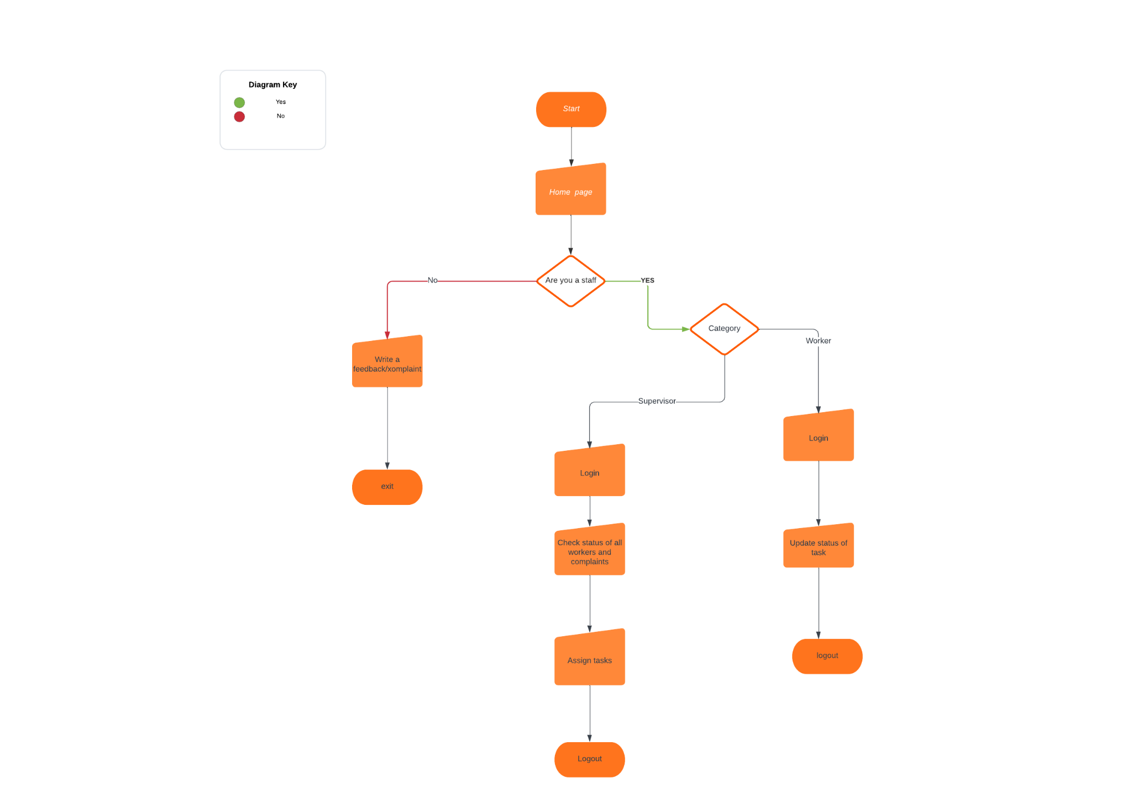
Flow Chart

Slide 13
SQLite Schema Structure
One worker may have many number of tasks
Similarly one supervisor may have many number of workers working under his supervision
So here to maintain variable size list of tasks and worker we are using a string
For worker Schema we have a field named taskArray which will contain all the tasks in form of string separated by commas (‘,’)
For supervisor schema we have a field named workerArray which will contain the id of all the workers separated by commas (‘,’)

Slide 14
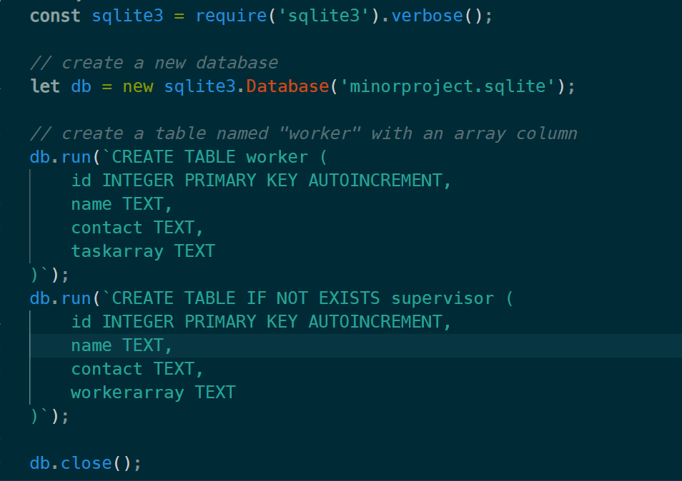
SQLite Schema(code)
Creating tables:-

Slide 15
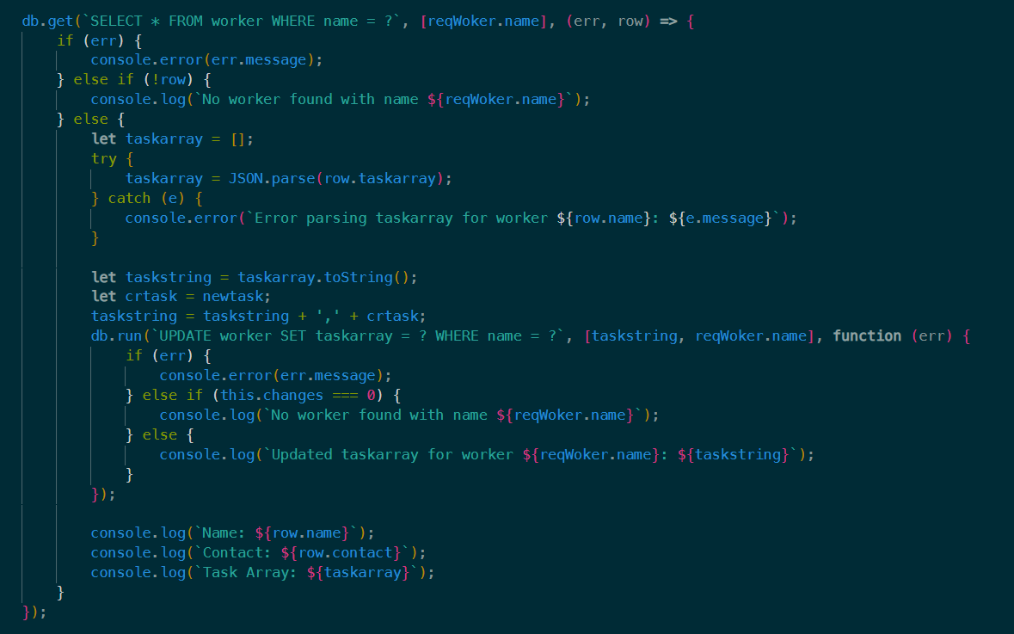
SQLite Schema (code)
Update command :

Slide 16
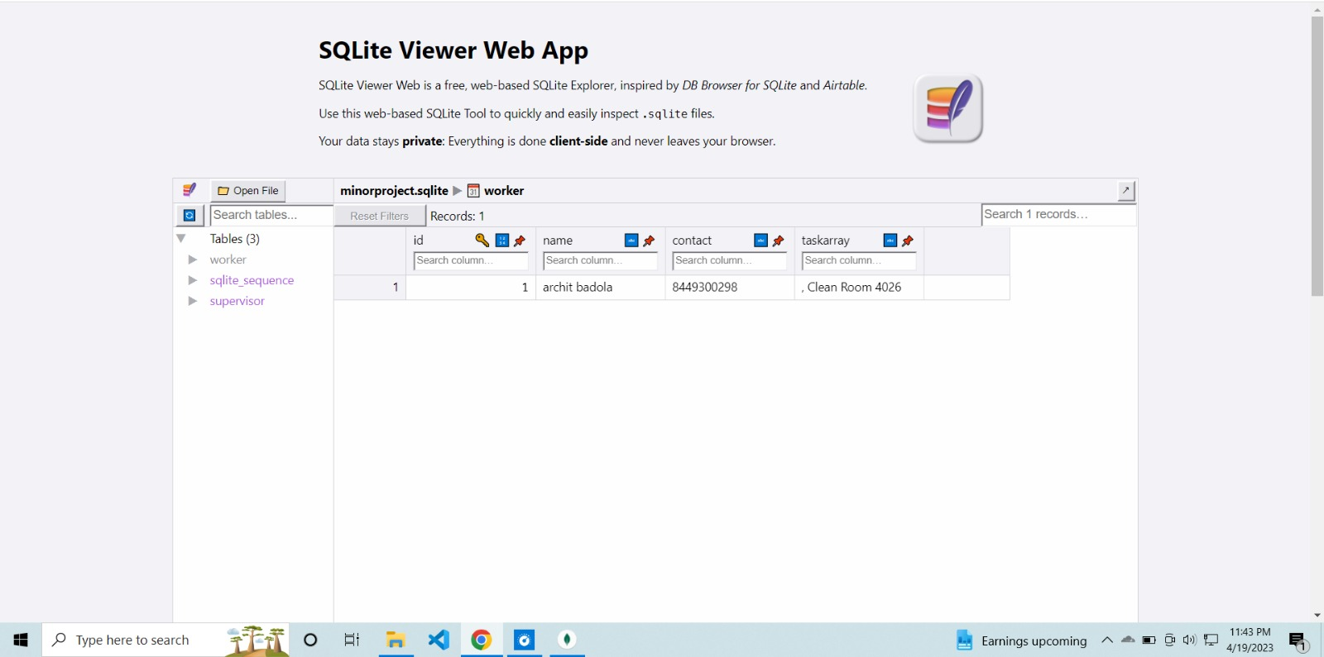
Tables after adding data

Slide 17
Home Page :
Customer will be allowed to post his experience in feedback section of the home page
There will be a option for staff members to login
Any feedback given will be converted to executable task with the help of Artificial Intelligence (AI)

Slide 18
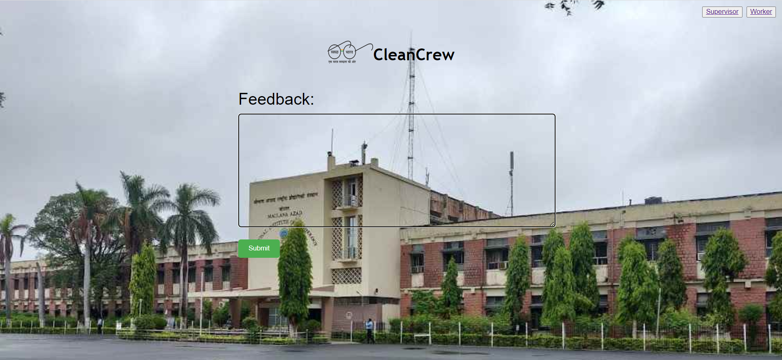
Home Page

Slide 19
Worker Profile Page
Each worker will be provided with credentials to log in to the portal
After successful login he will be able to see his profile
His profile contains list of tasks assigned to him which are pending
Profile Page will also contain his name and contact so that he can be supervised and contacted easily by supervisor
Each task will have a done button which can be clicked to mark the task completed

Slide 20
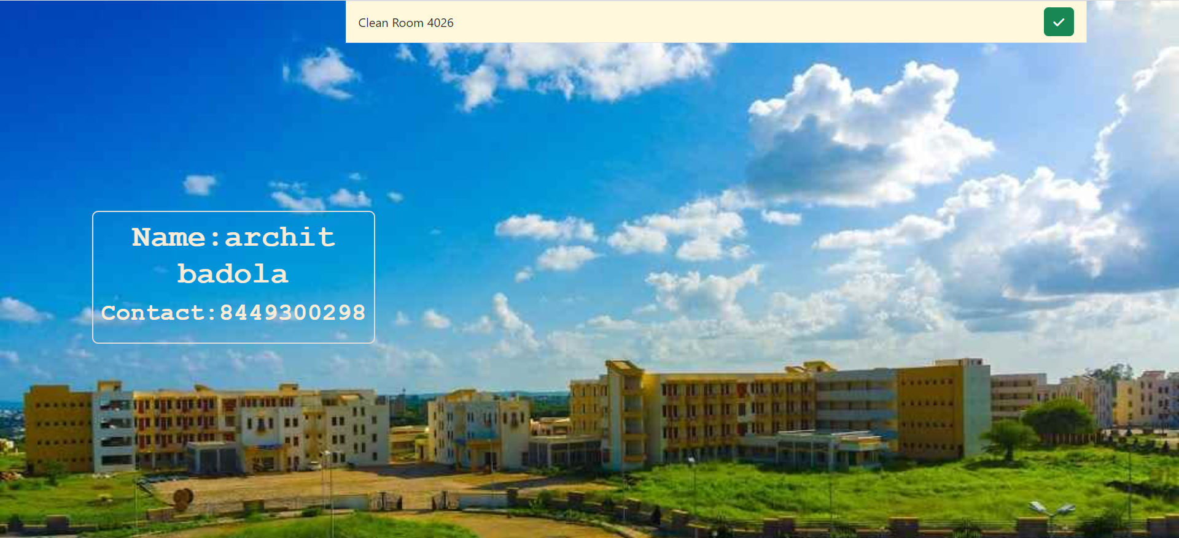
Worker Profile Page

Slide 21
Supervisor profile page
Each supervisor will be provided with credentials to log in to the portal
After successful login he will be able to see his profile
His profile contains list of worker assigned to him who are working for organization
Profile Page will also contain his name and contact
Supervisor will be able to see list of worker who are under his supervision
He will have access to profile page of every worker who is under his supervision

Slide 22
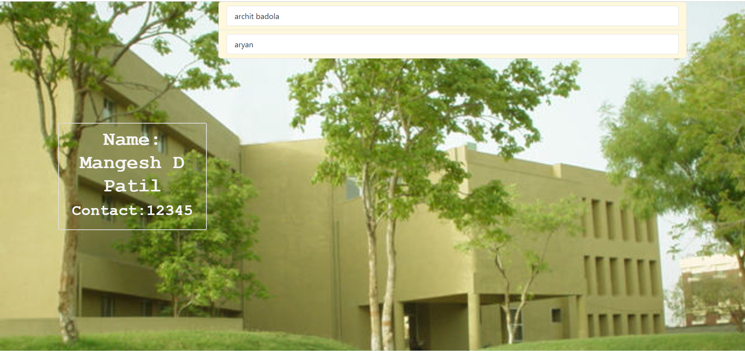
Supervisor Profile Page

Slide 23
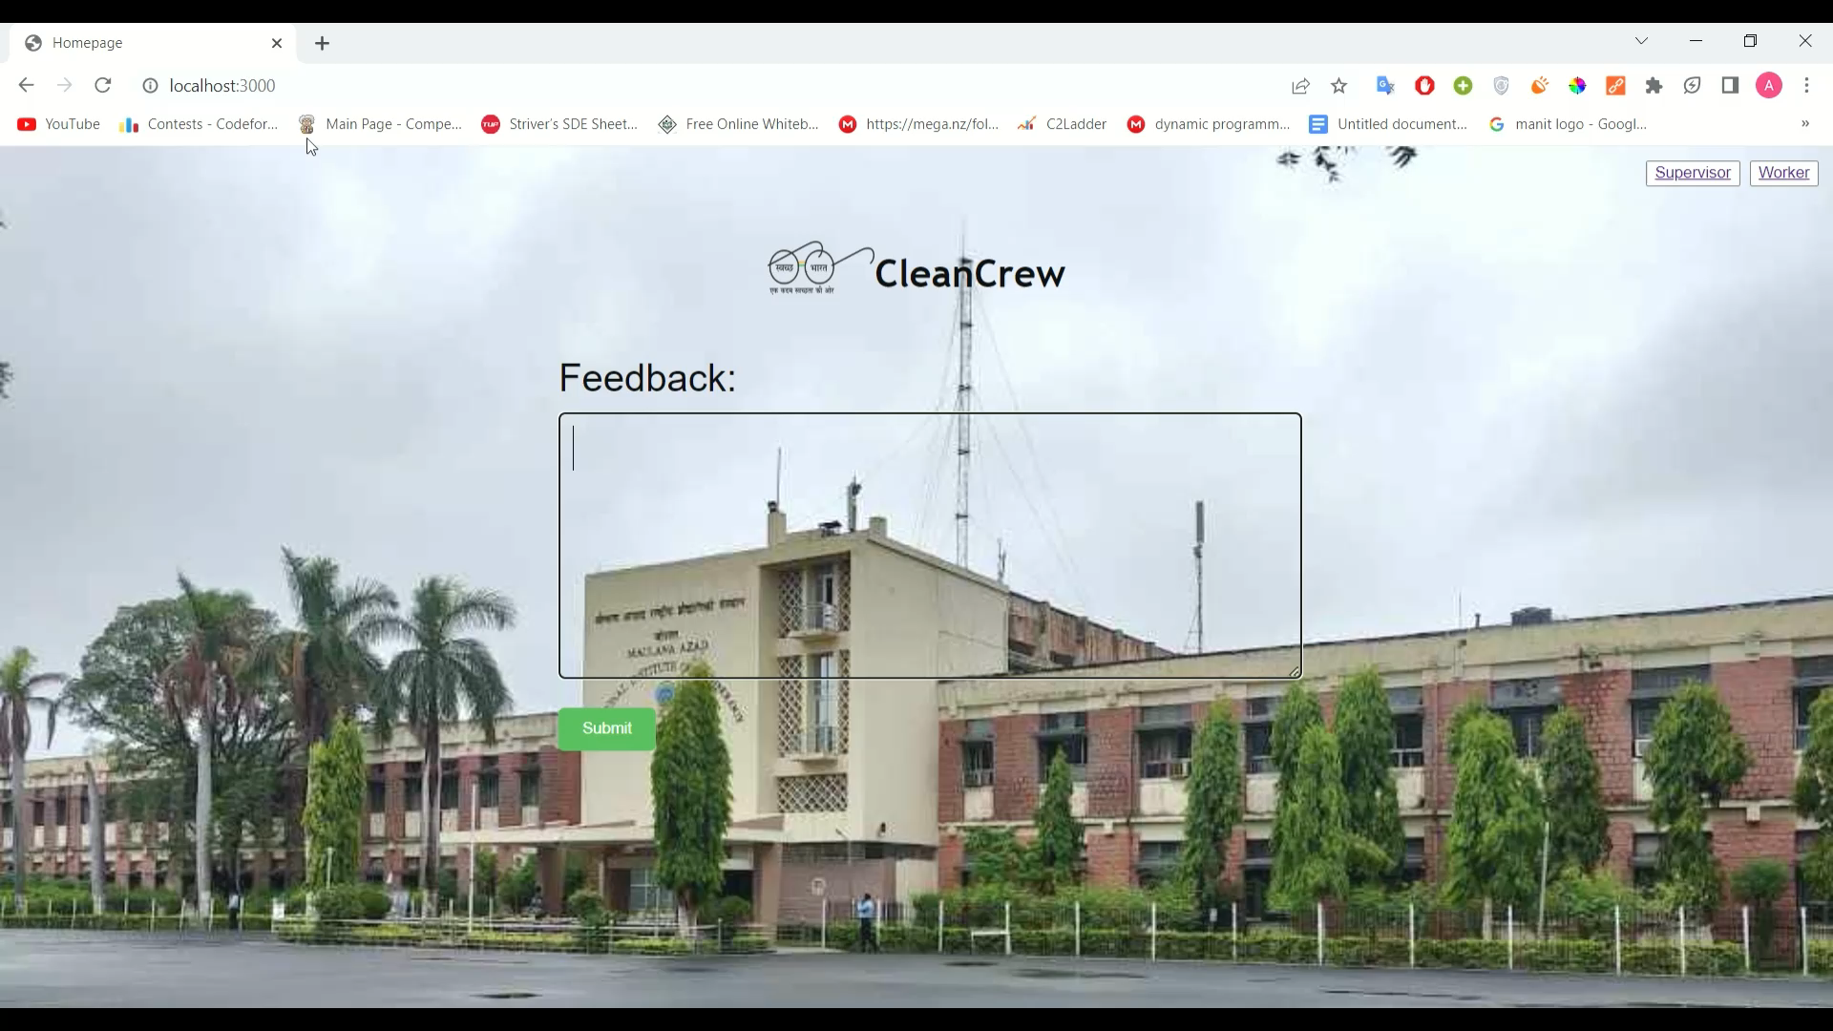

Slide 24
References
https://www.freeprojectz.com/project-source-code-database-download/employee-management-system-project
http://www.123seminarsonly.com/CS/Employee-Management-System.html
https://www.researchgate.net/publication/347615091_Employee_Management_System
https://www.claysys.com/appforms/template/employee/
https://phpgurukul.com/employee-management-system-using-sqlite/

Slide 25


